Slide 1


Slide 2
CAMPUS RECRUITMENT SYSTEM
BATCH : 5769
TRAINER:SANTOSH MALI

Slide 3
LANGUAGE
HTML
CSS
JAVA SCRIPT
VISUAL STUDIO CODE

Slide 4


Slide 5
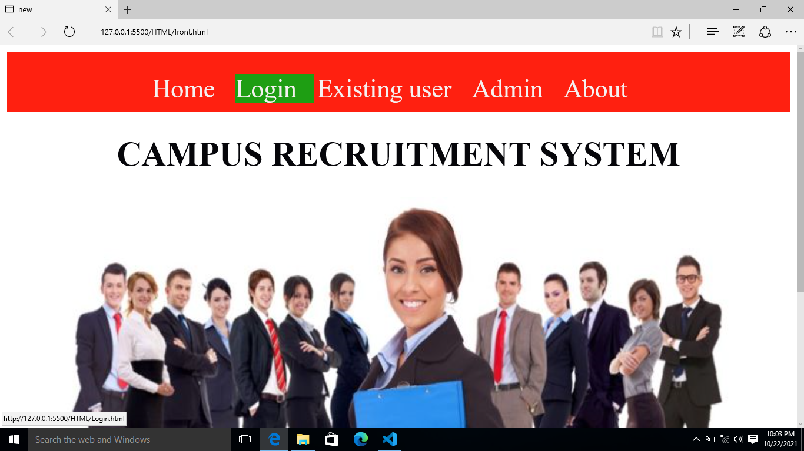

Slide 6
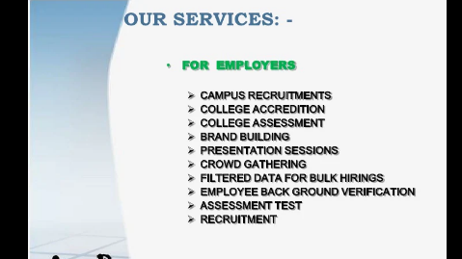

Slide 7
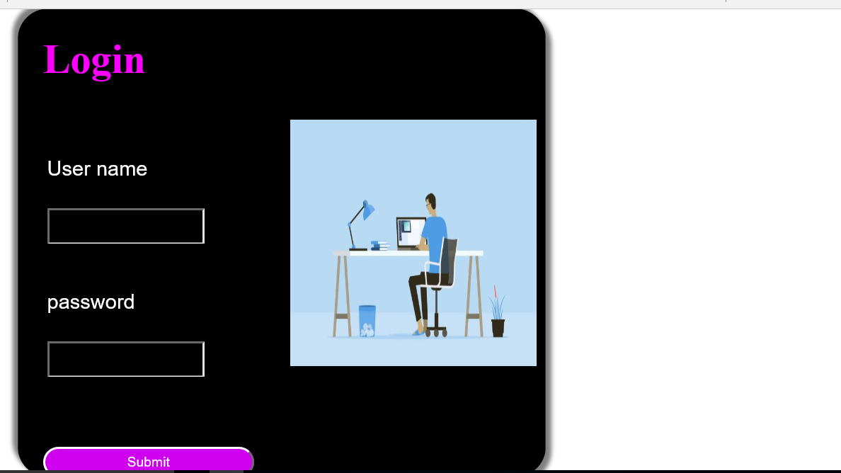

Slide 8
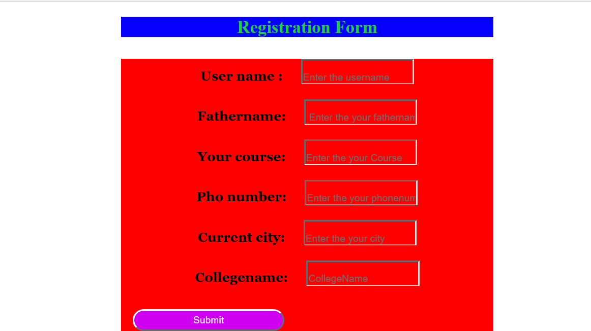

Slide 9
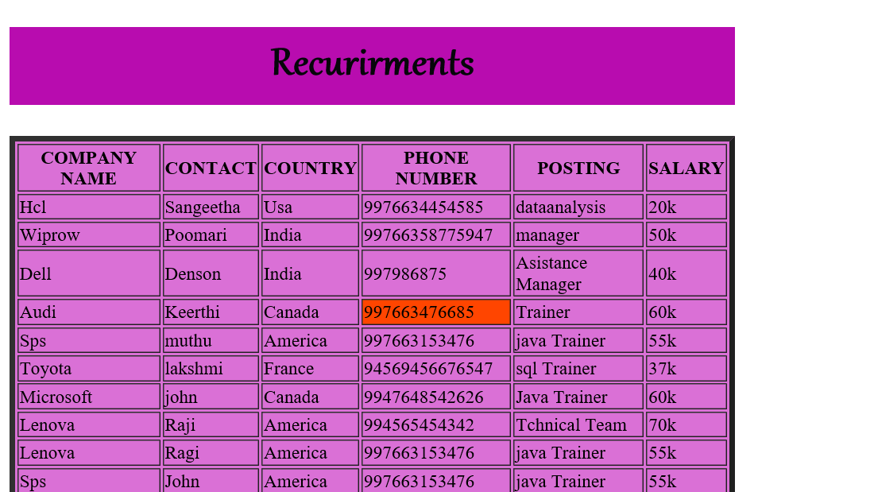

Slide 10
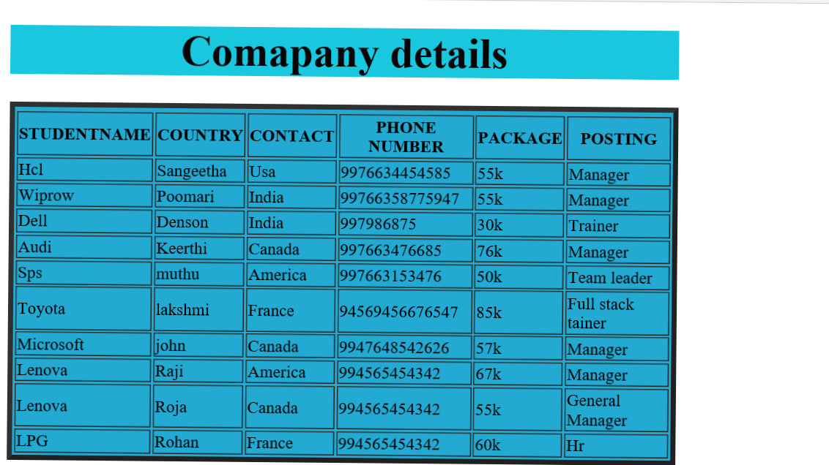

Slide 11
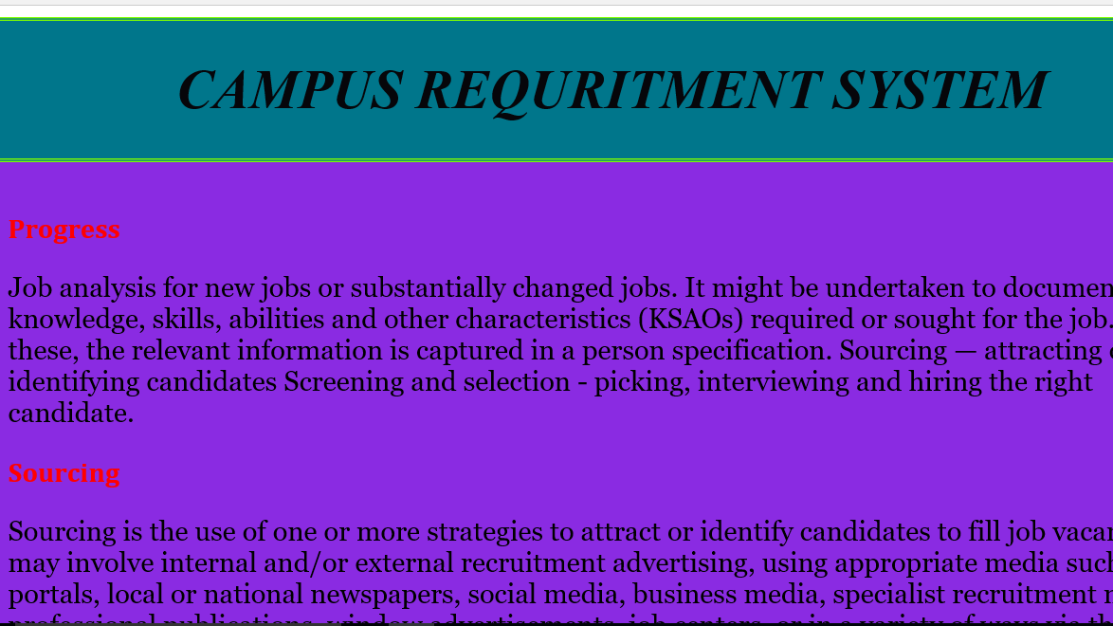

Slide 12

T.Poomari

